Slide 1
Creating an open-source game of Skittles
(mostly in pictures)

Slide 2
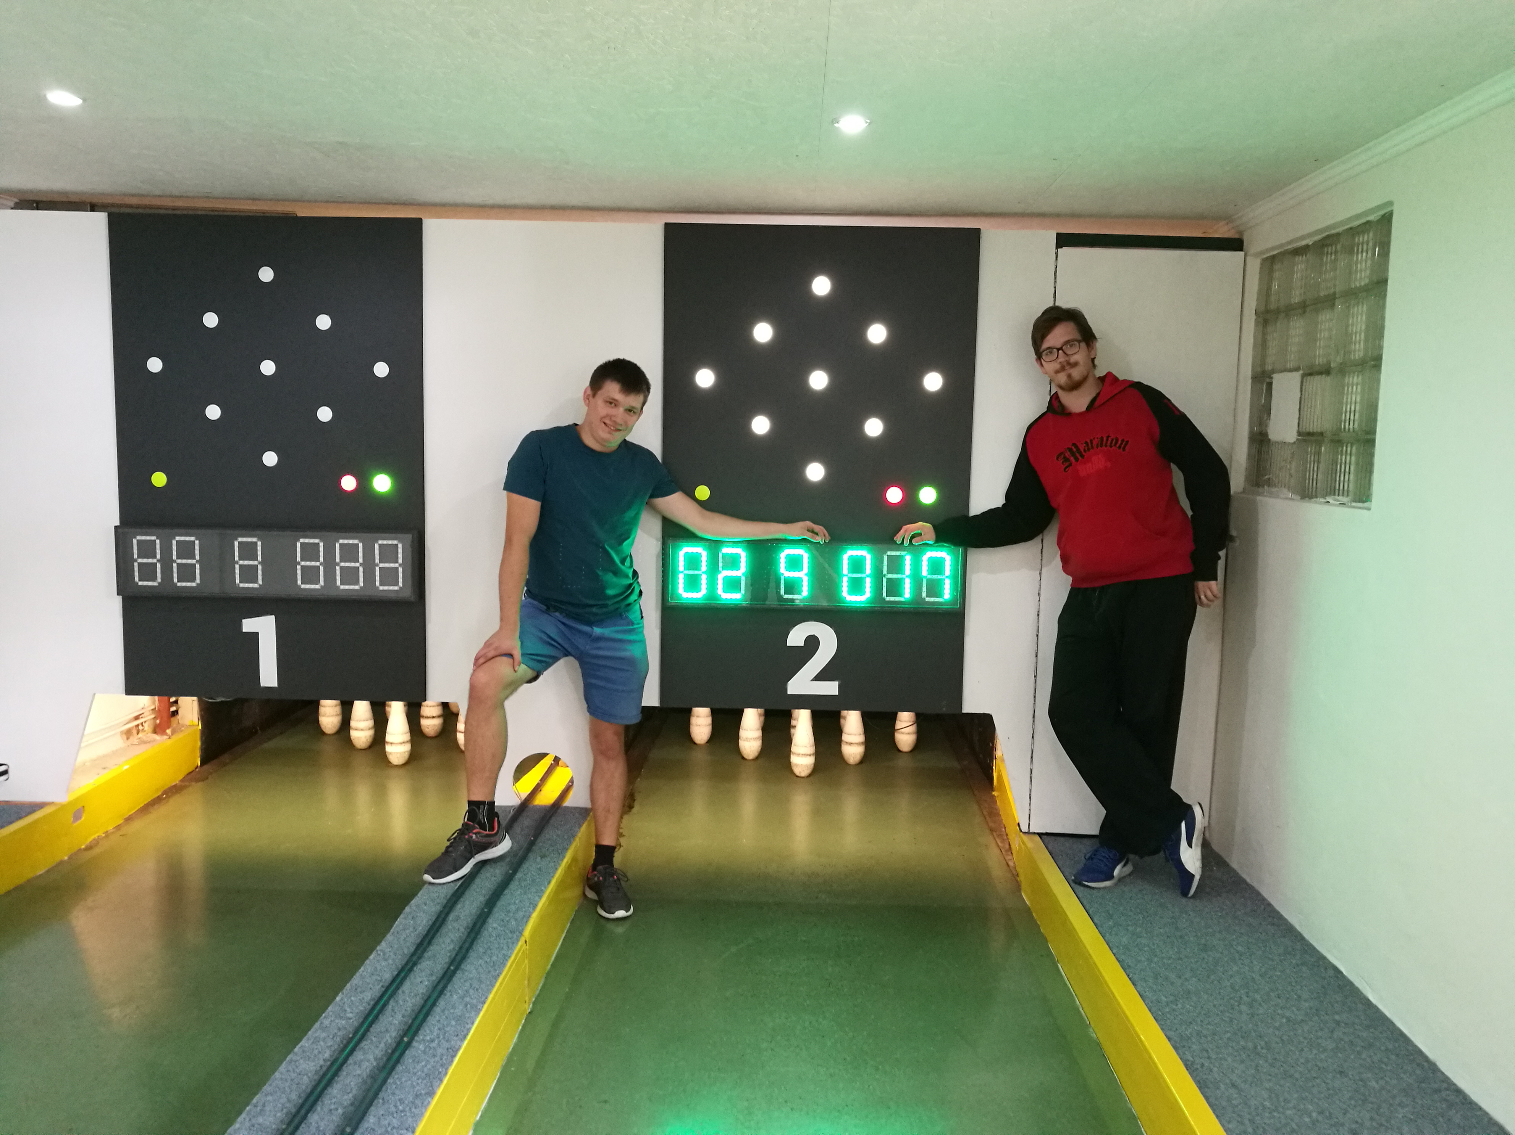

Slide 3
About us
Michal Kohútek
CS student
Open-source fanboy since 2007
Ubuntu user 7.04
Raspberry Pi addict
Michal Paulína
Electronic engeneering student
Very pragmatic dual-booter
Arduino junkie

Slide 4
So… what’s are skittles?

Slide 5
Skittles
Older cousin of bowling.
Smaller balls, no holes.
9 pins (ergo Project Ninepins)

Slide 6
Before...
…there were no digital cameras and the pictures were lost in time.

Slide 7
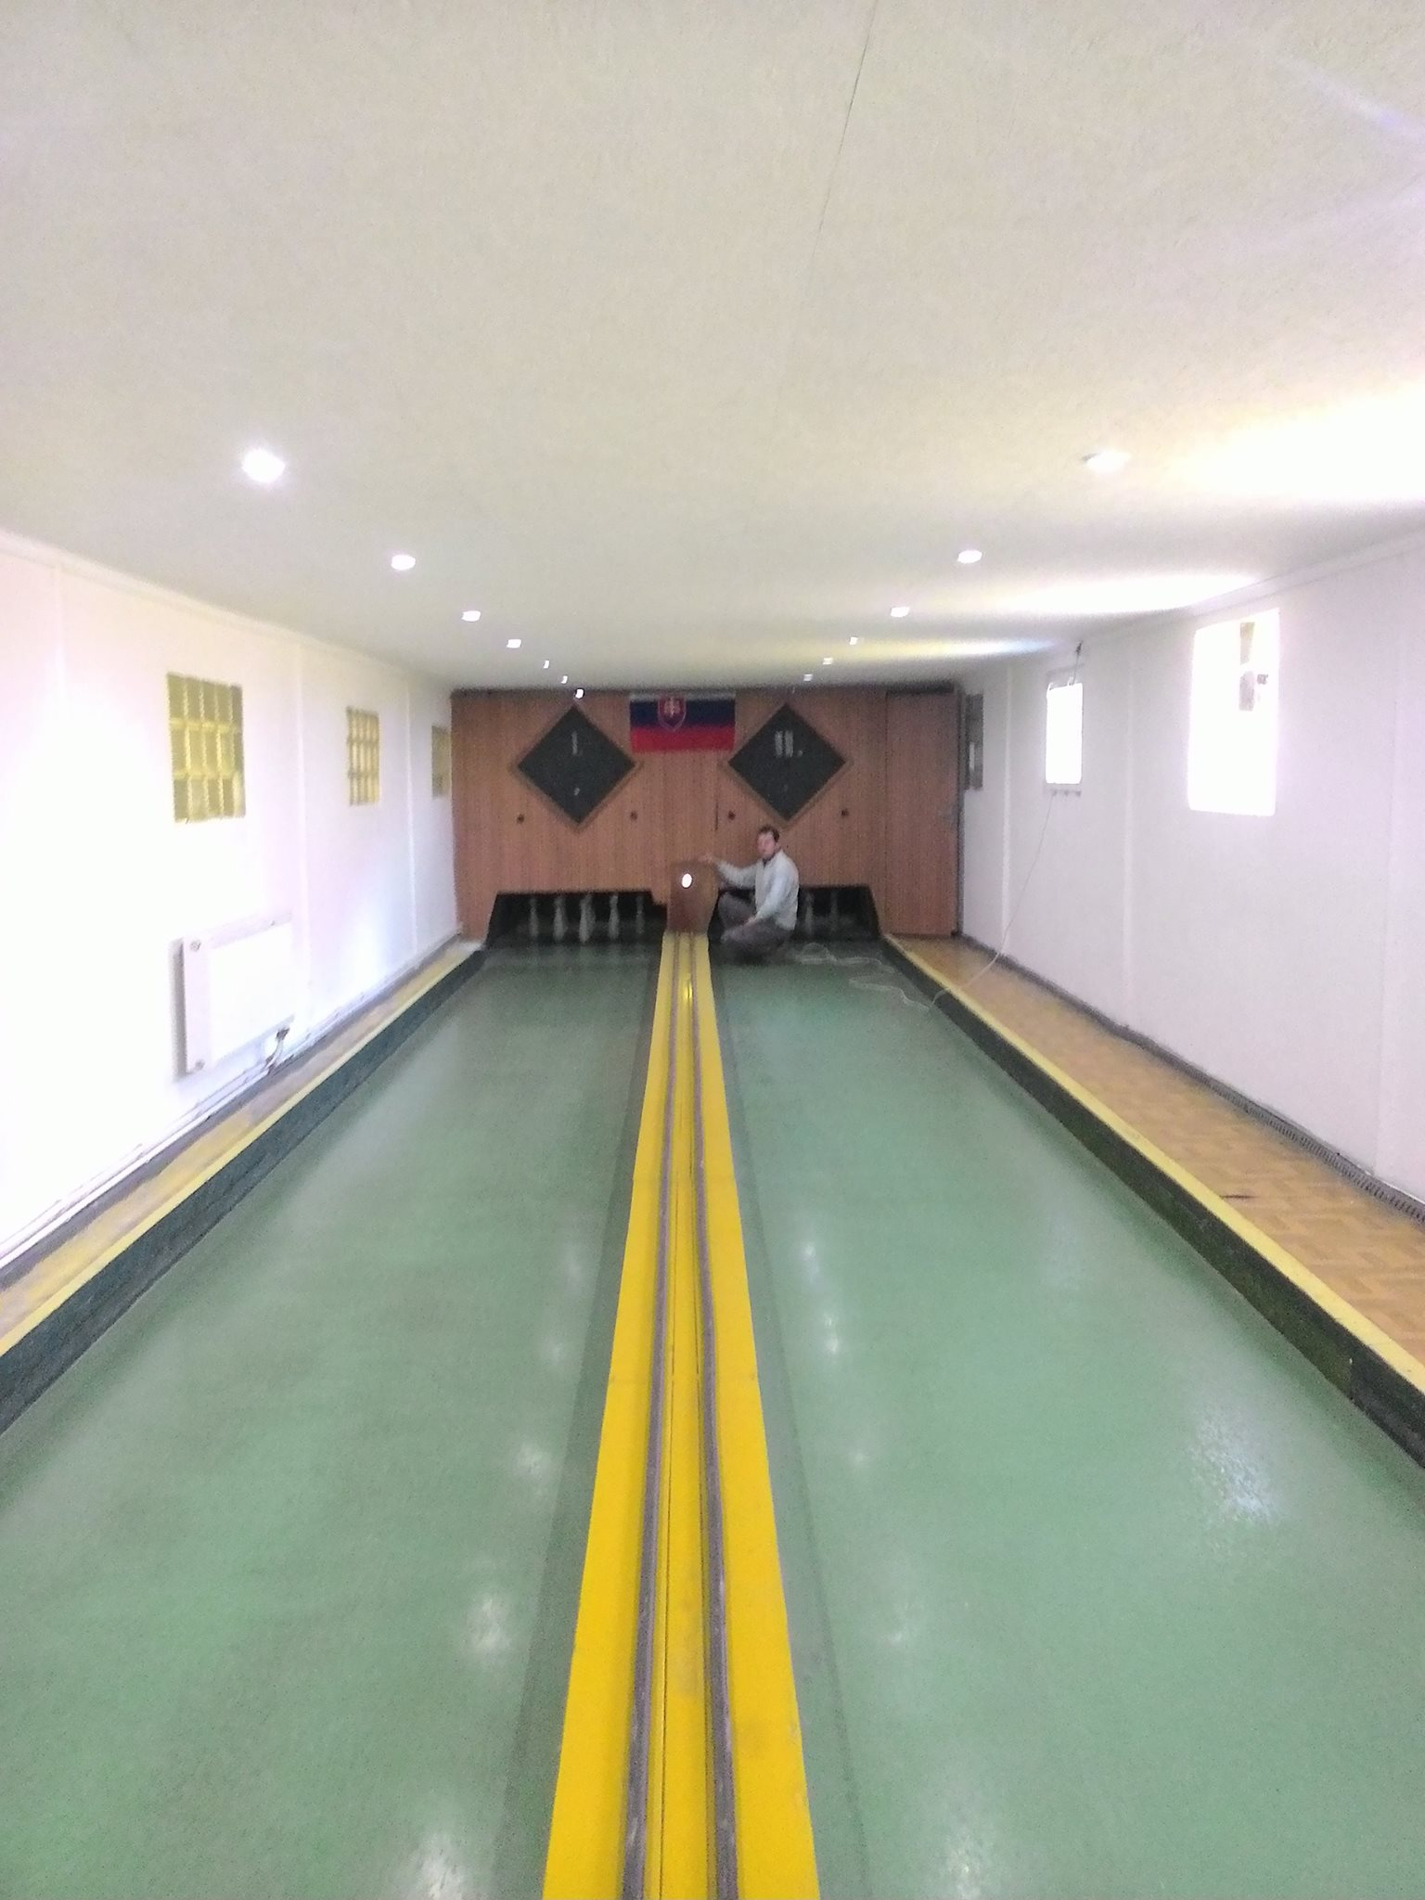
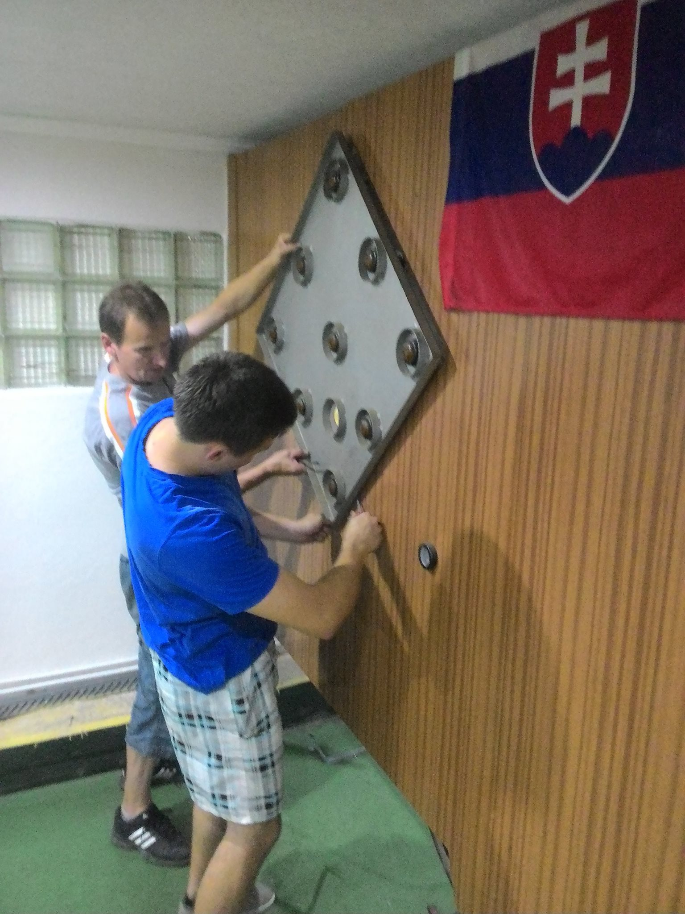
Replacing the old machine

Slide 8
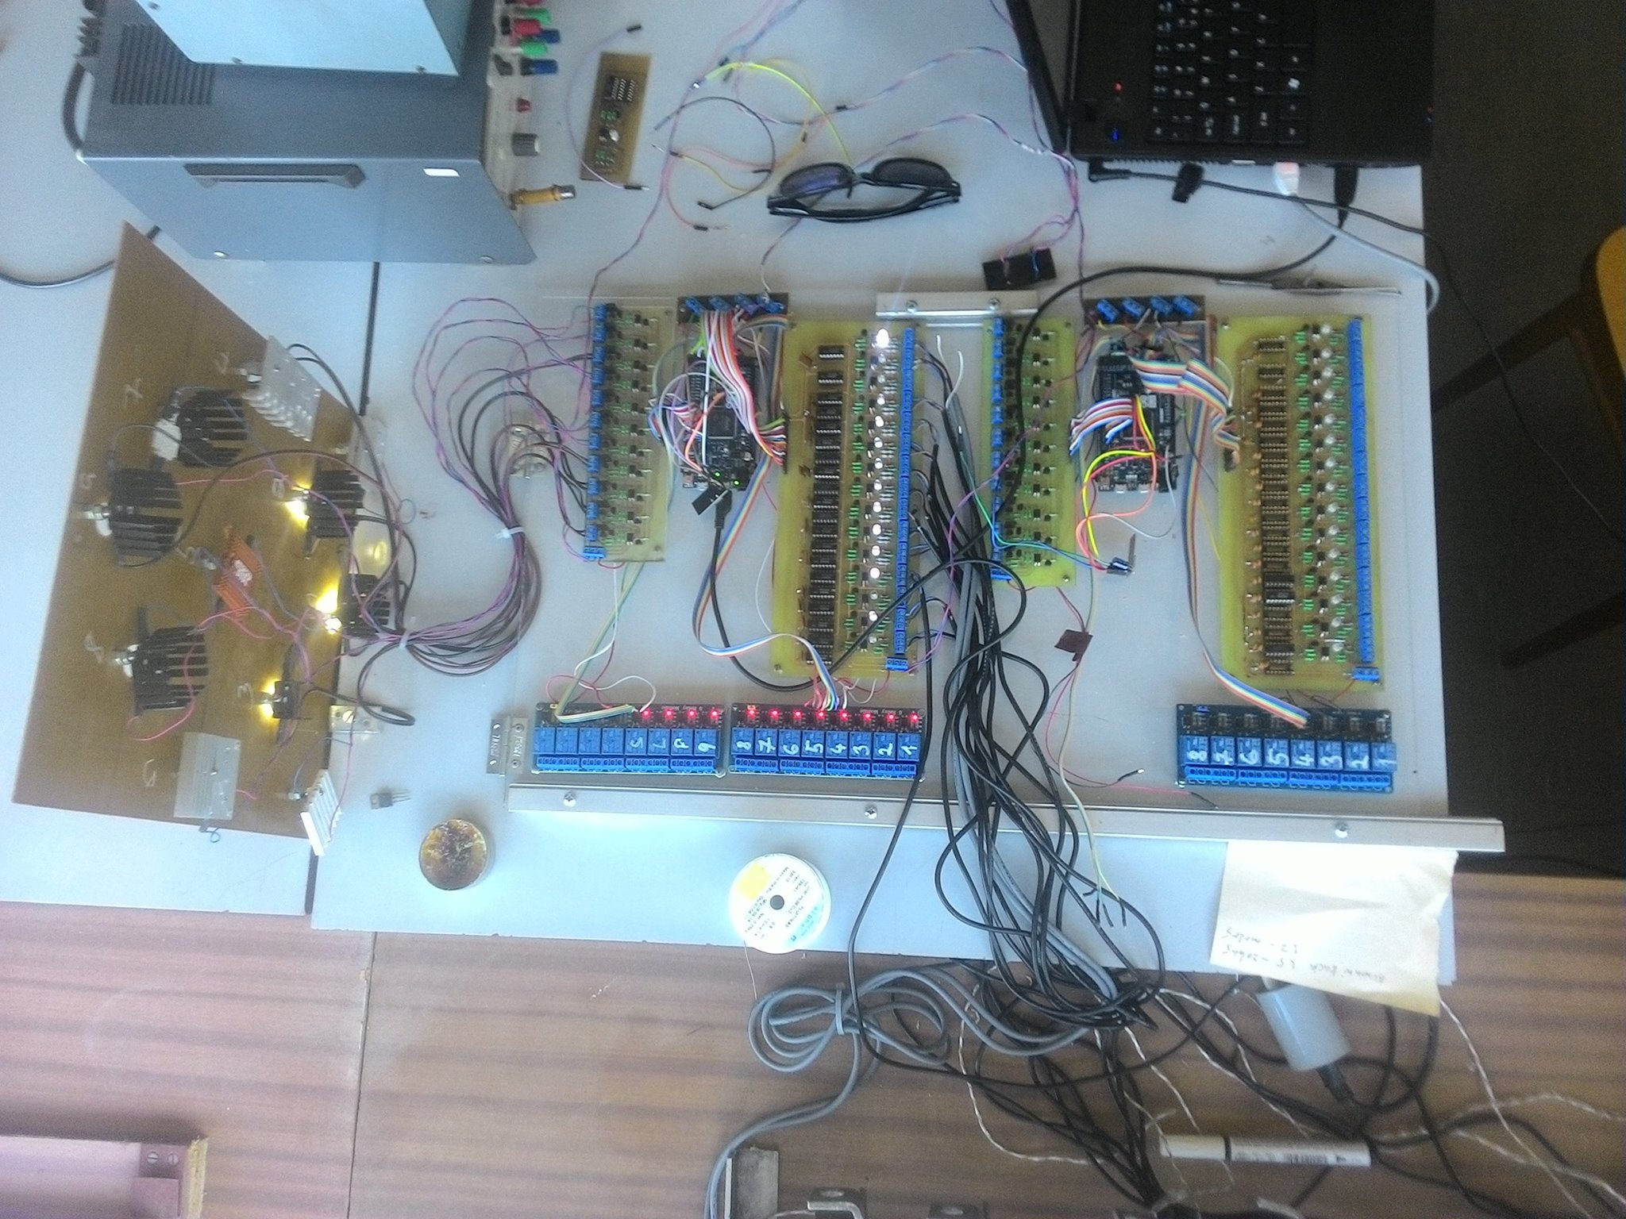

Slide 9
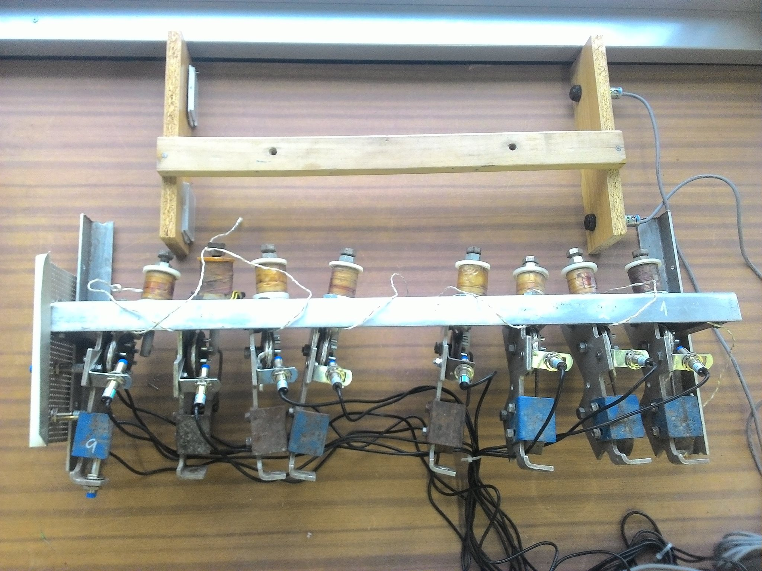

Slide 10
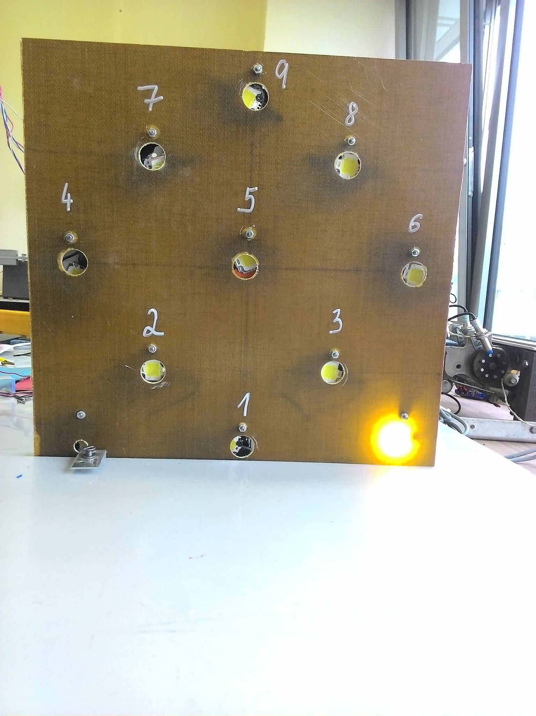

Slide 11
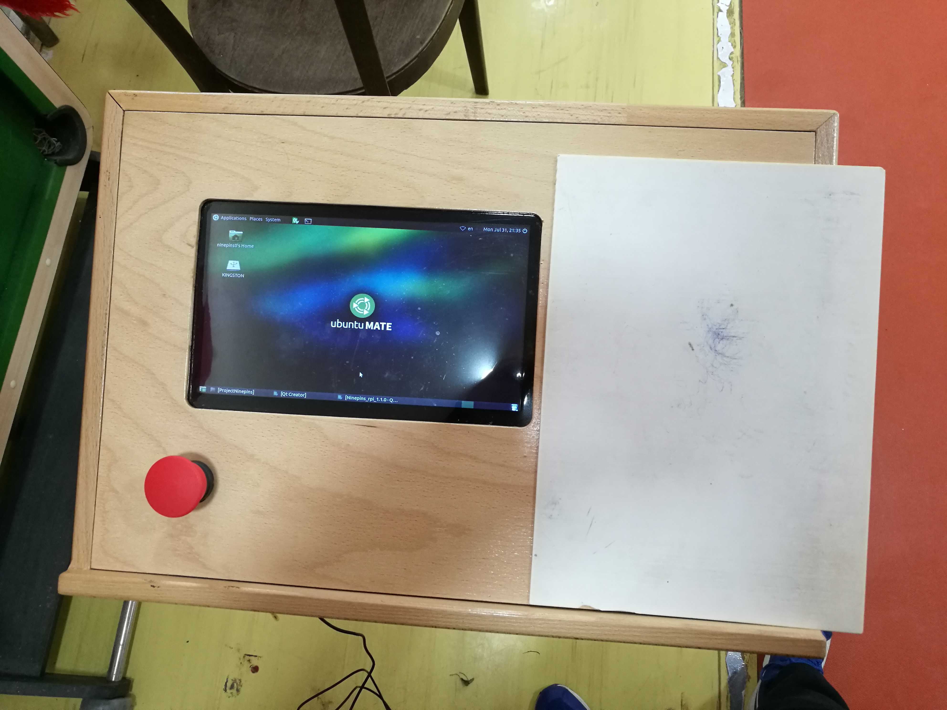

Slide 12
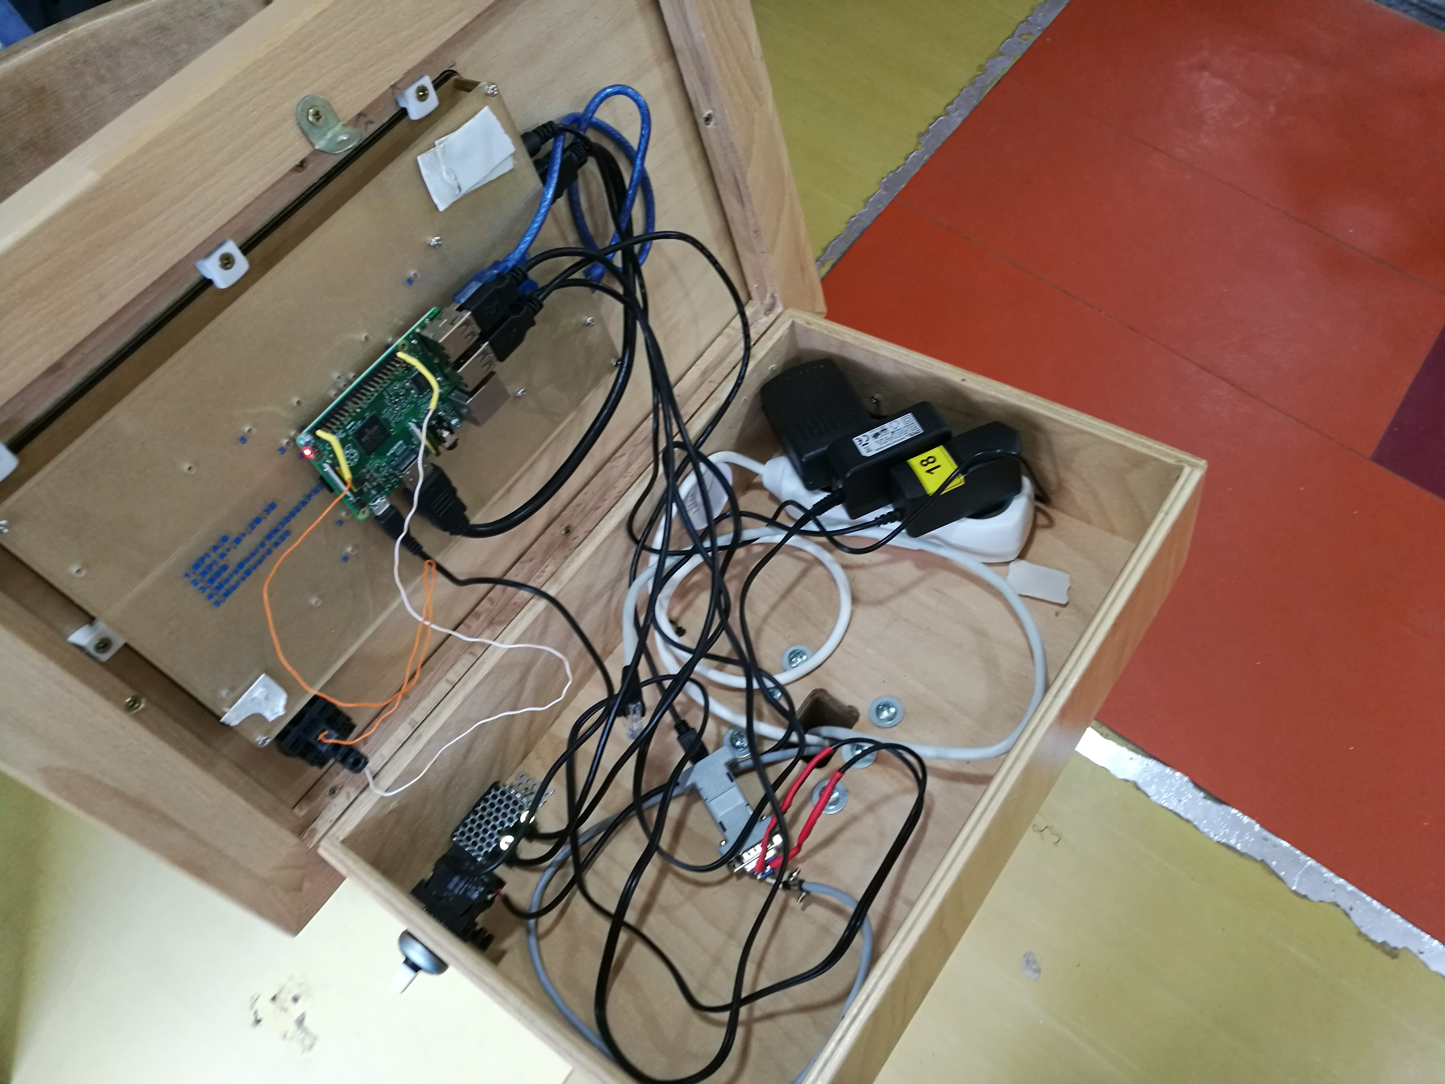

Slide 13
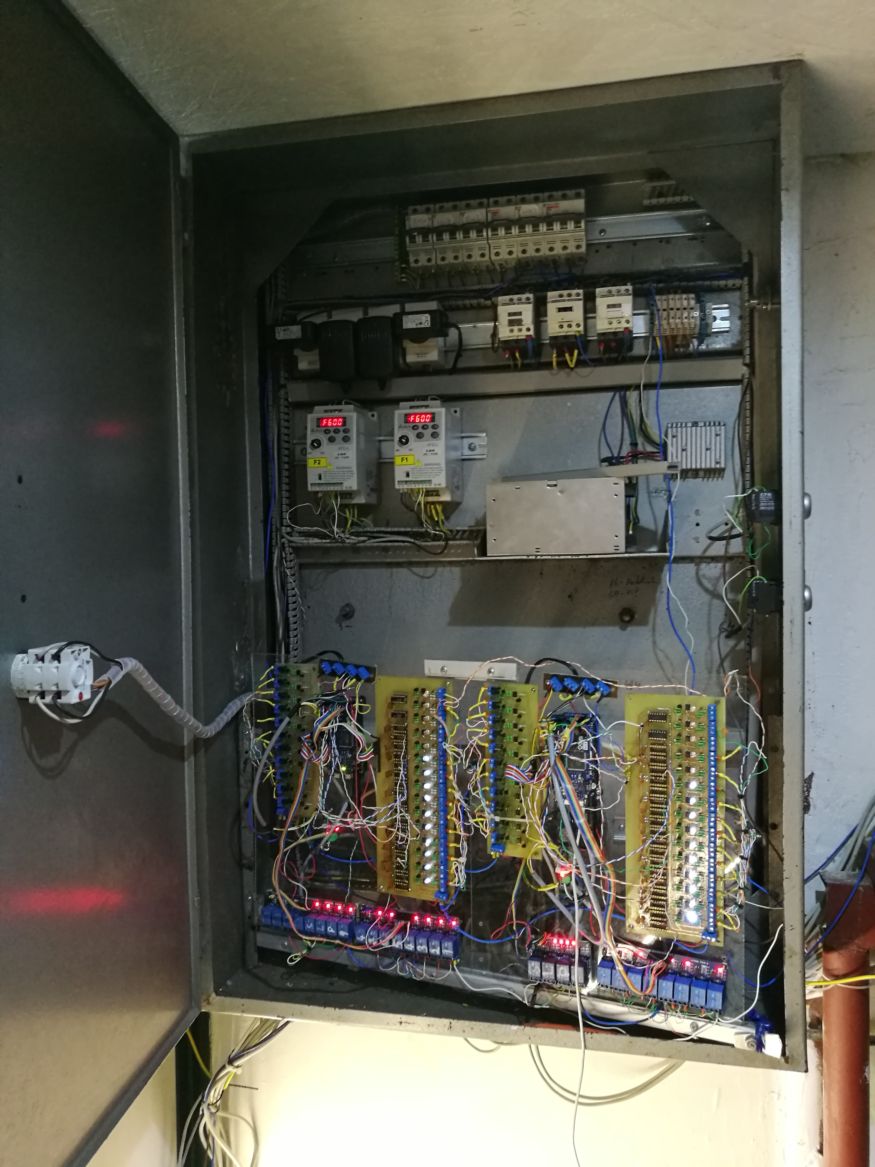

Slide 14
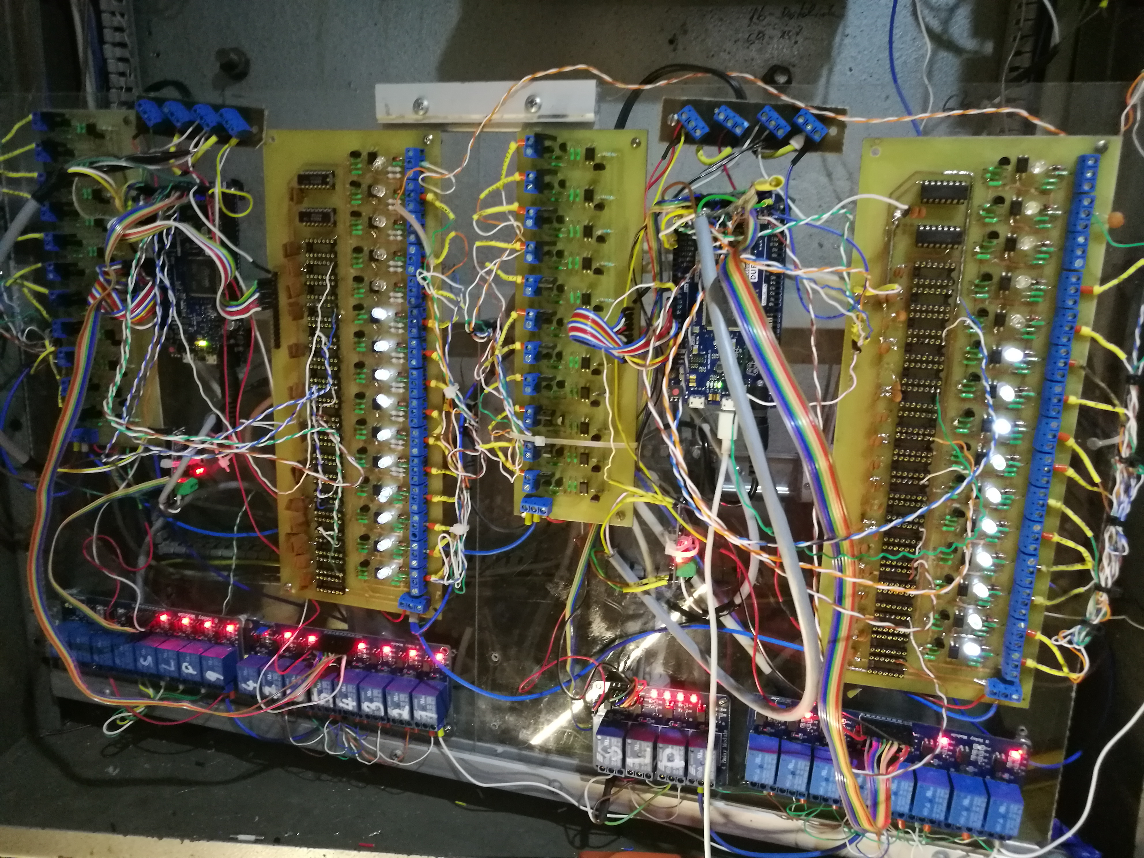

Slide 15
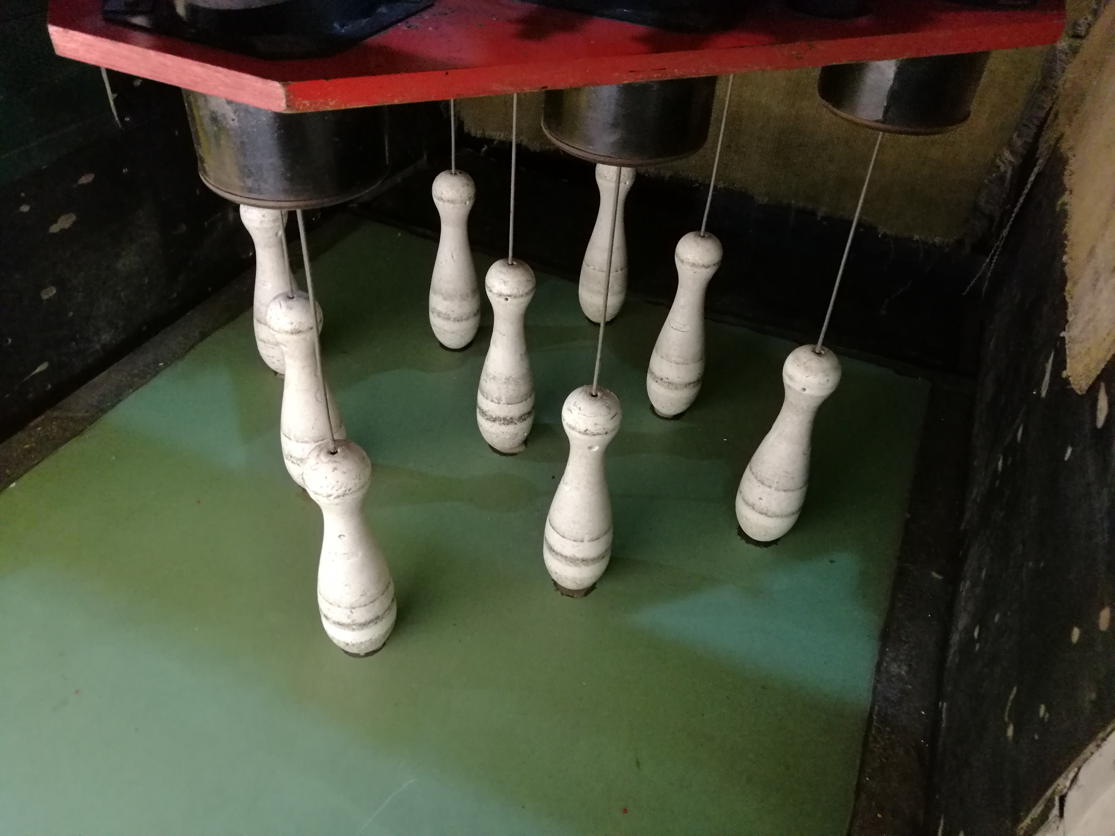

Slide 16
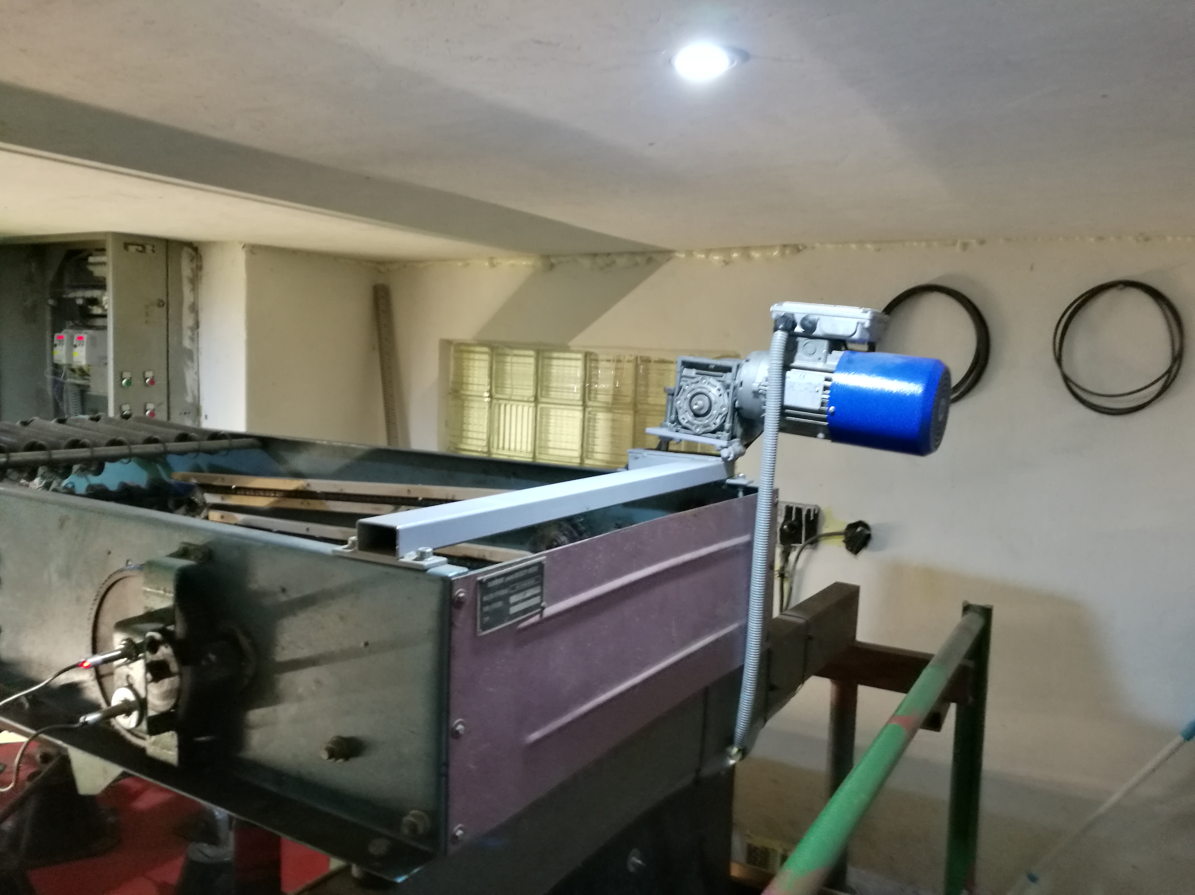

Slide 18
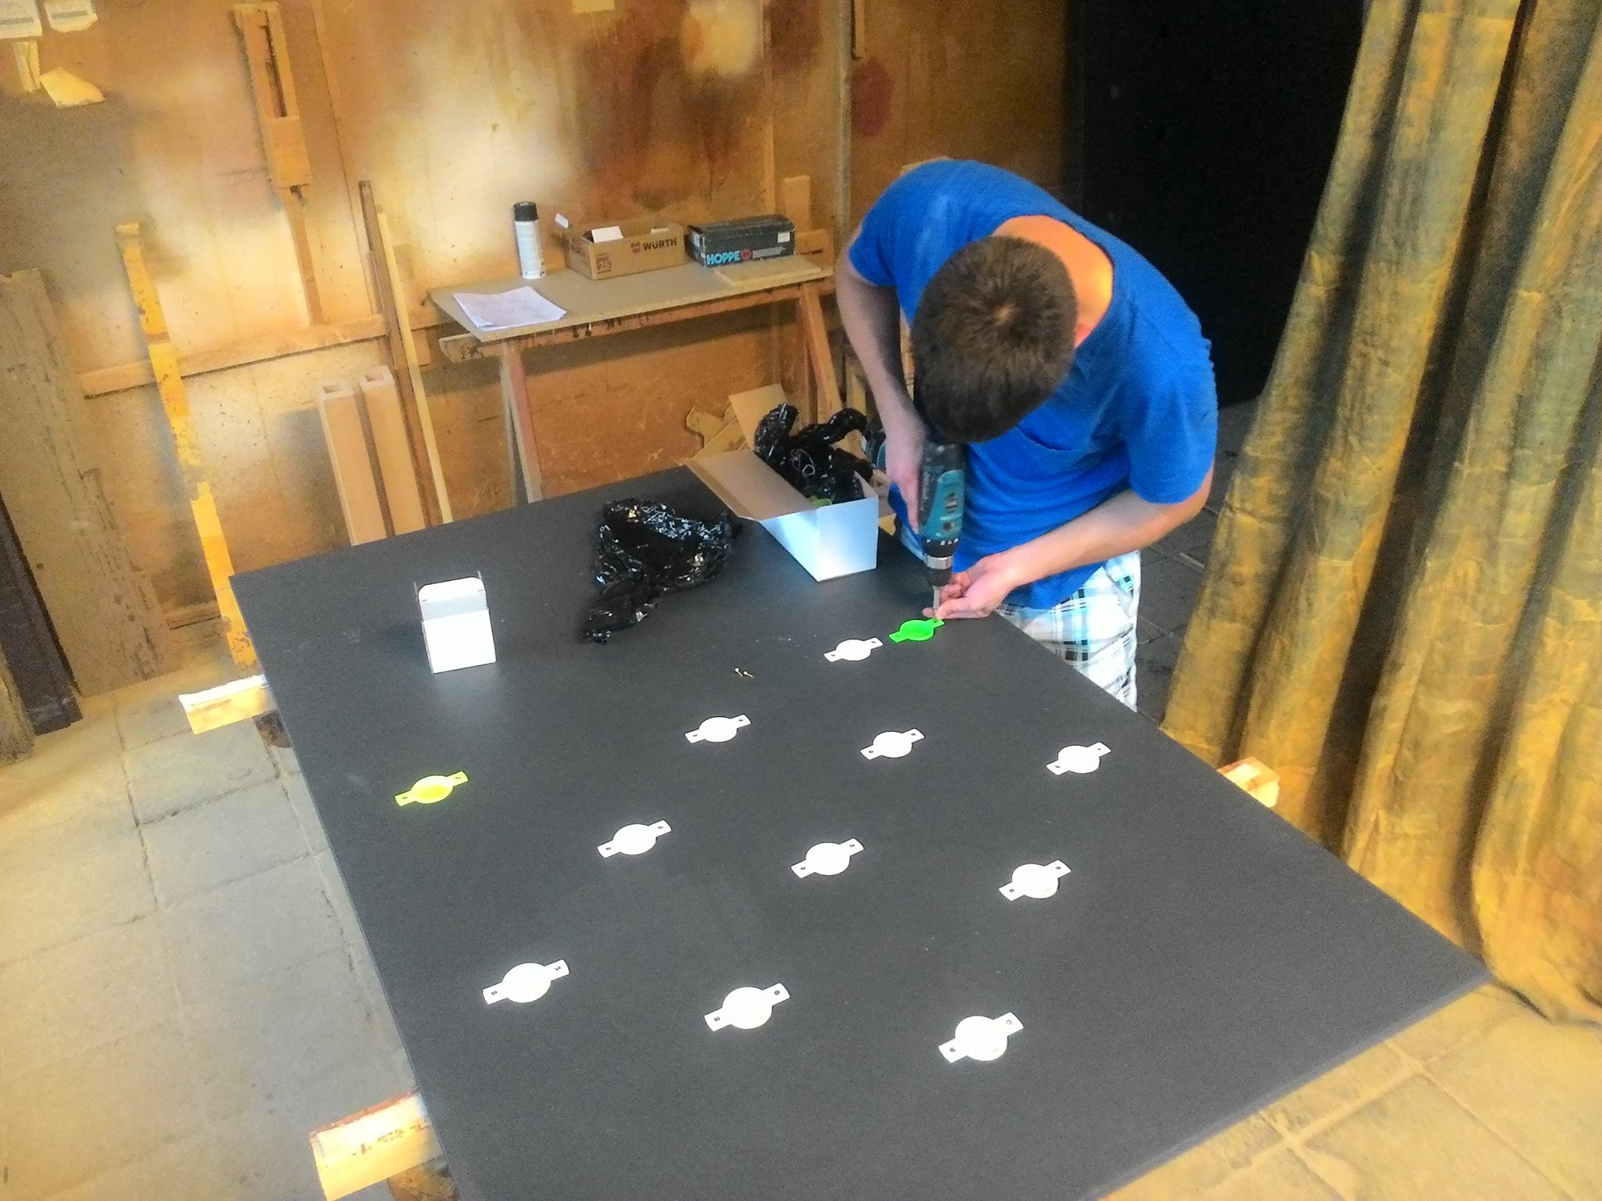

Slide 19
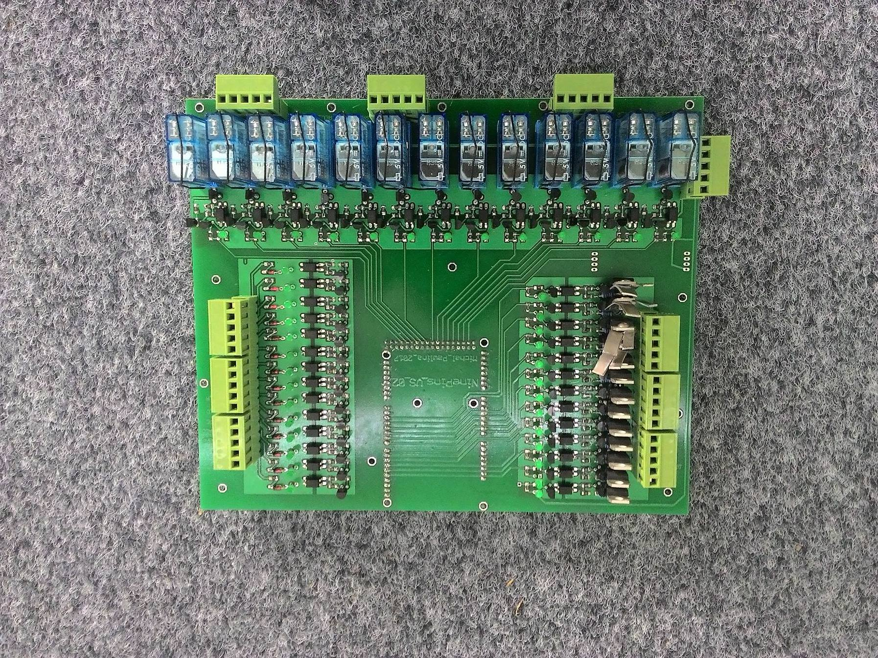

Slide 20
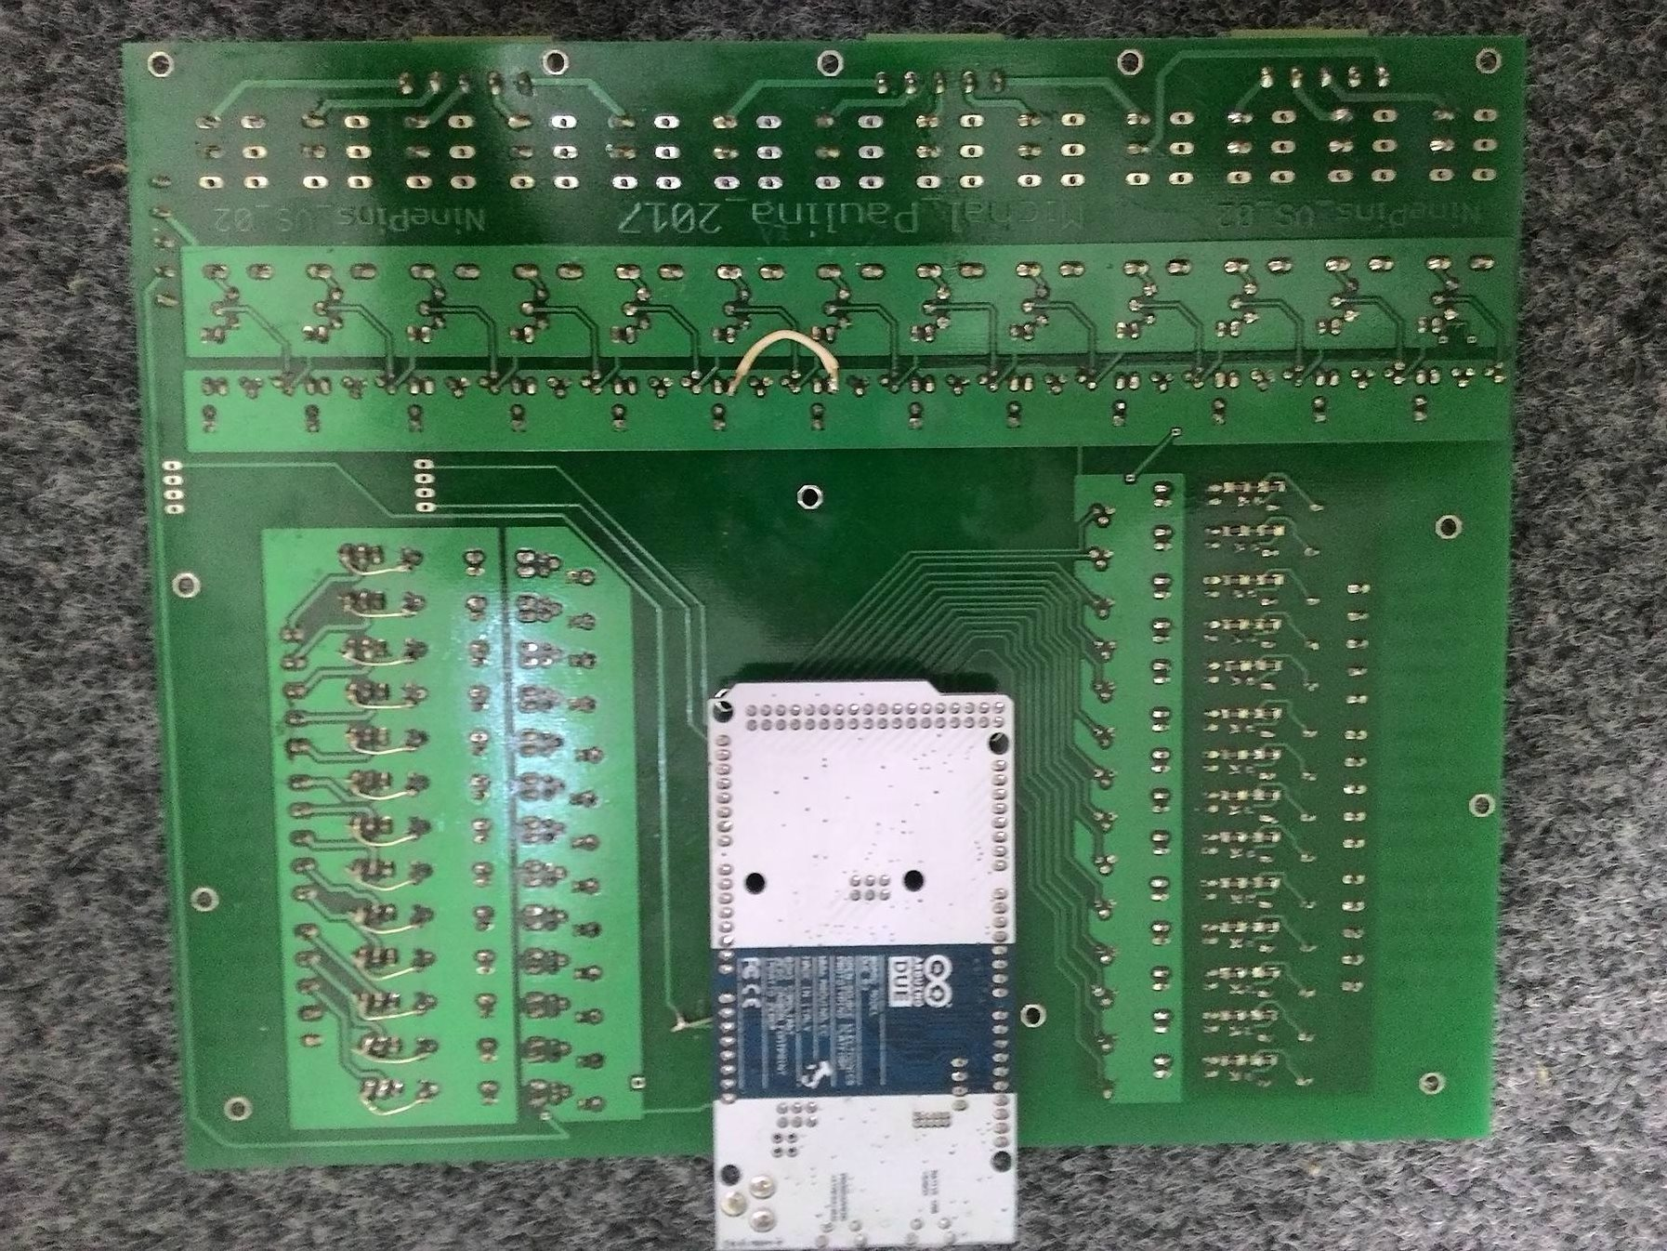

Slide 21
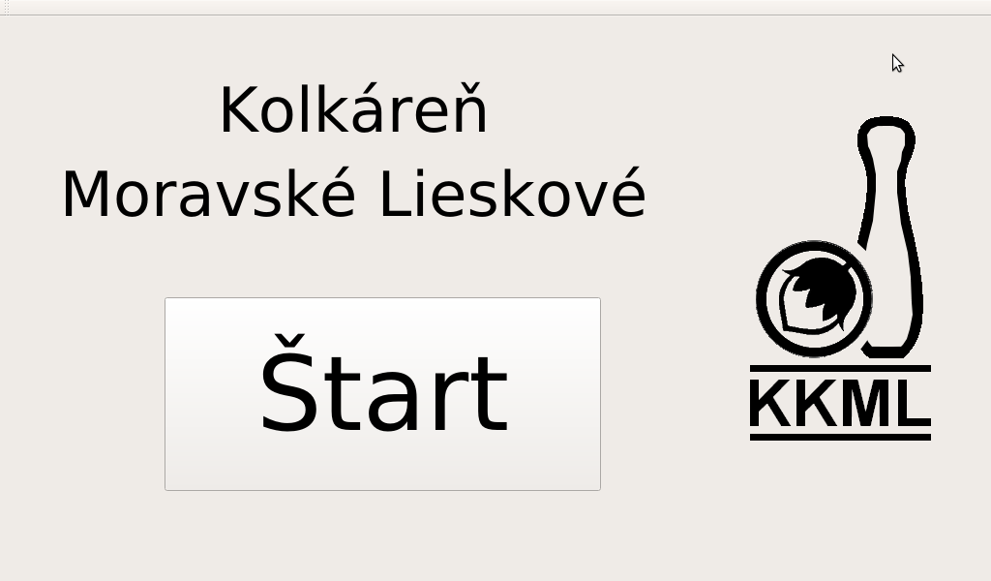

Slide 22
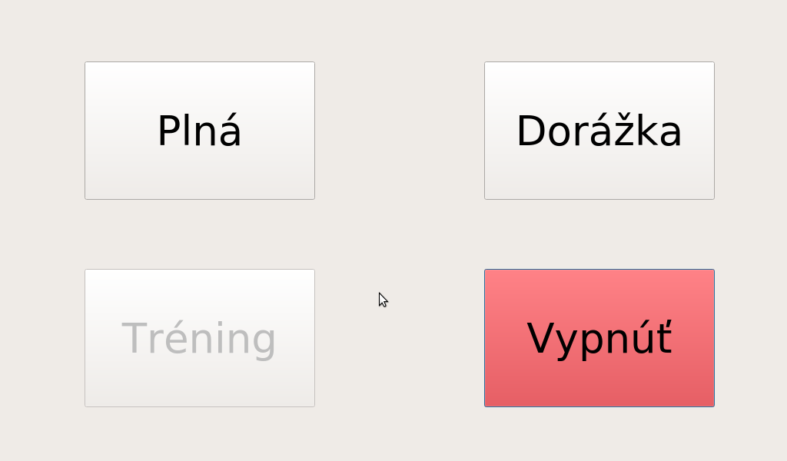

Slide 23


